Slide 1
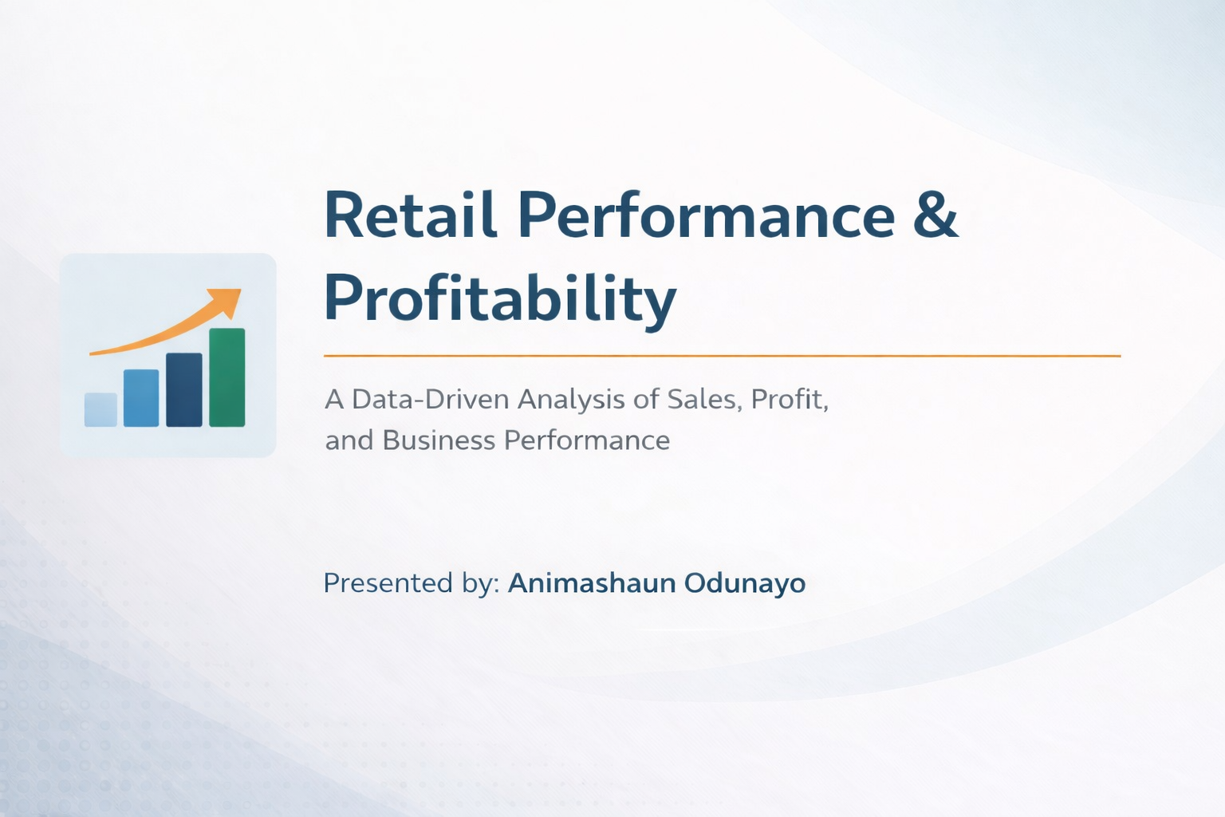

Slide 2
PROJECT OUTLINE
Introduction
About the Dataset
Problem Statement
Aim and Objectives
Research Questions
Charts and Visualizations
summary
Recommendation

Slide 3
introduction
This project focuses on analyzing retail data from a superstore data using power bi to understand sales
Performance , profitability and customer behavior with the goal of supporting better business decisions
The goal is to uncover key insight that can drive better business performance

Slide 4
About the dataset
The dataset used for this project is a superstore dataset, which contains retail transaction data from A company based in united state.
It covers key product category of furniture , office supplies, technology
The dataset includes important variables like sales , profit , discounts, product categories and geographic regions over a specific period of time
The dataset enables the analysis of overall business performance , customer behavior and profitability trends

Slide 5
Problem statement
Despite recording high sales volumes, many retail businesses struggle to achieve consistent and sustainable profitability. This challenge often arises from factors such as excessive discounting, poor product performance, inefficient regional strategies.
In the case of the superstore dataset, there is evidence that while certain products and regions generate significant sales, they do not contribute proportionately to profit. In some instances, products are sold at very low margins or even at a loss due to high discount levels.

Slide 6
Aim and objectives
The aim of this project is to analyze sales, profit and to evaluate overall business performance
Objectives
To identify top-performing products and regions
To examine the impact of discounts on profitability
To evaluate sales trends over time

Slide 7
Research question
Which product categories and sub category generate the highest and lowest profit?
How do sales and profit change over time(monthly trends)?
Which region contributes the most to sales but least to profit?
How do discounts affect profit across different product categories?

Slide 8
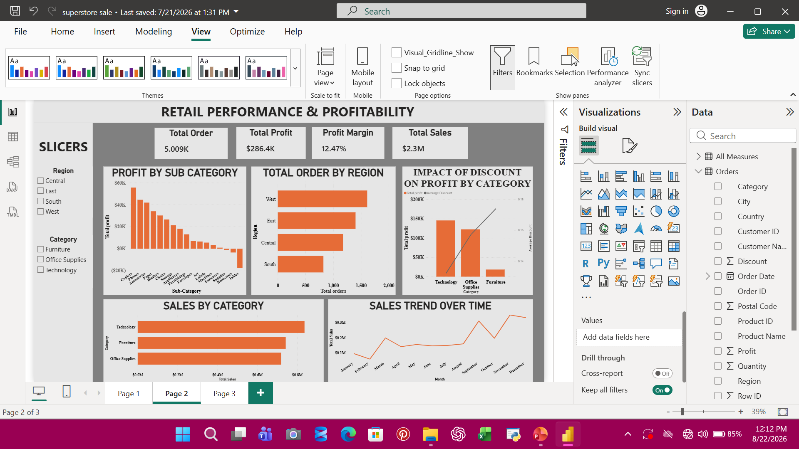

Slide 14
summary
The analysis of the superstore dataset shows that although the business is generating strong overall sales, profitability remains inconsistent across different product categories, regions, and customer segments.
A key finding is that high discount levels significantly reduce profit margins, especially in certain product categories like furniture, where some products are sold at very low profit. This indicates that aggressive discount strategies are not always effective and may be harming overall financial performance.
In terms of product performance, technology products tend to generate higher profits, while some sub-categories within furniture and office supplies underperform. This suggests that not all high-selling products contribute positively to profitability.
Regional analysis reveals that some regions contribute heavily to total sales but generate relatively low profit, pointing to possible issues such as high operational costs, inefficient pricing strategies, or excessive discounting in those areas.

Slide 15
recommendation
Based on the findings I recommend
Reducing excessive discounts on low-profit products
Improving performance in underperforming regions
Monitoring sales growth trends for strategic planning

